Slide 1
Vertical Handoff in Heterogeneous Wireless Networks
Submitted to: Dr. Yossuf Khazbak

Slide 2
Team 1
  Muhammad Alaa
  Muhammad Ahmad Hesham
  Hossam Alaa
  Mahmoud Amr

Slide 3
AGENDA
  Heterogeneous Wireless Networks (HWN)
  Vertical Handoff
  Vertical Handoff Management Process
  Vertical Handoff Decision Techniques
  Game Theory Introduction
  Game Theory in Vertical Handoff

Slide 4
Heterogeneous Wireless Networks (HWN)
  Heterogeneity of WN architectures important feature of next generation of WN
  Mobile devices equipped with multiple radio access technologies RATs.
  HWN is a hierarchal structure of Coexistent different RATs like 2.5G, 3G, 4G, 5G, Wi-Fi, etc.
Notes:
For example, a wireless network that provides a service through a WLAN and is able to maintain the service when switching to a cellular network is called a wireless heterogeneous network.
Different RATs are not separated you can switch for example between 4G and Wi-Fi with a press of a button causing the phone to disconnect from the wifi and connect to the 4G

Slide 5




Heterogeneous Wireless Networks (HWN)

Slide 6

Heterogeneous Wireless Networks (HWN)

Slide 7

Heterogeneous Wireless Networks (HWN)

Slide 8
Heterogeneous Wireless Networks (HWN)

Slide 9
Heterogeneous Wireless Networks (HWN)

Slide 10
Heterogeneous Wireless Networks (HWN)

Slide 11

Heterogeneous Wireless Networks (HWN)

Slide 12
Heterogeneous Wireless Networks (HWN)
Mobility
4G
1990
2003
2010
high
3G
2G
2.5G
WiMAX
1G
medium
802.11g
pedestrian
802.11b
Cordless Phone
Stationary
Data Rates
Basic voice
Compressed video
HQ multimedia
Text
Graphics

Slide 13
Heterogeneous Wireless Networks (HWN)
  RATs differ in (Network Coverage, Bandwidth, etc.).
  HWNs Integrate all these different RATs to roam seamlessly.
  Higher levels in HWN hierarchy have higher coverage but less bandwidth.
  HWN is an Always Best Connected (ABC) network.

Slide 14
AGENDA
  Heterogeneous Wireless Networks
  Vertical Handoff
  Vertical Handoff Management Process
  Vertical Handoff Decision Techniques
  Game Theory Introduction
  Game Theory in Vertical Handoff

Slide 15
Vertical Handoff
  Handoff is when a Mobile Terminal (MT) changes its point of attachment from on access point (AP) to another of same or different RAT.

Slide 16
Vertical Handoff
  Handoff Classifications:
    Horizontal handoff (Intra-Network handoff)
    Vertical handoff (Inter-Network handoff)
      Upward VHO
      Downward VHO
    Diagonal handoff

Slide 17

Vertical Handoff
  Handoff Classifications:
Vertical Handoff
Horizontal Handoff

Slide 18
Vertical Handoff
  Handoff Classifications:
  Horizontal handoff
    when an MT moves from one cell to another within the same RAT.
    Main reasons:
      Poor Signal Quality (RSS)
      Bandwidth
      Velocity of MT
Notes:
RSS is received signal strength

Slide 19
Vertical Handoff
  Handoff Classifications:
  Horizontal handoff
    Steps:
      Handoff Initiation.
      Channel Assignment.
      Connection Transfer / handoff execution.

Slide 20
Vertical Handoff
  Handoff Classifications:
  Vertical handoff
    when an MT moves from one RAT to another e.g. from Wi-Fi cell to a GSM/UMTS cell.
    Upward VHO: from lower size cell of a RAT with higher BW to bigger size cell of different RAT with lower BW.
    Downward VHO: opposite of upward VHO.

Slide 21
Vertical Handoff
  Handoff Classifications:
  Vertical handoff
Satellite
GSM
WiMAX
downward VHO
Upward VHO
Wi-Fi
Bluetooth

Slide 22
Vertical Handoff
  Handoff Classifications:
  Diagonal handoff
    Combination of vertical and horizontal handoffs.
    Termed as Media Independent Handover (MIH) in IEEE 802.21

Slide 23
Vertical Handoff
  Vertical Handoff Decision Criteria:
  Network Related Attributes
  User Related Attributes
  User Preferences

Slide 24
Vertical Handoff
  Vertical Handoff Decision Criteria:
  Network Related Attributes
    Bandwidth
    Network coverage
    Usage cost, Delay
    Signal to Noise Ratio (SNR)
    Received Signal Strength (RSS)
    Signal to Interference Ratio (SIR), Carrier to Interference Ratio (CIR)

Slide 25
Vertical Handoff
  Vertical Handoff Decision Criteria:
  Network Related Attributes
  User Related Attributes
  User Preferences

Slide 26
Vertical Handoff
  Vertical Handoff Decision Criteria:
  User Related Attributes
    Remaining Battery Power.
    Speed of Mobile Terminal.
    Type of Service Requested.

Slide 27
Vertical Handoff
  Vertical Handoff Decision Criteria:
  Network Related Attributes
  User Related Attributes
  User Preferences

Slide 28
Vertical Handoff
  Vertical Handoff Decision Criteria:
  User Preferences
    User preferences are expressed in terms of relative user preference weights.

Slide 29
Vertical Handoff
  Vertical Handoff Research Challenges:
  Seamless Handoff
  Timing
  Throughput
  Security
  Power consumption
  Quality of Service (QoS) & Quality of Experience (QoE)

Slide 30
Vertical Handoff
  Vertical Handoff Research Challenges:
  Seamless Handoff
    Uninterrupted application execution during handoff.
  Timing
    when to handoff? To reduce No. of Handoffs, Ping pong effect and Handoff failure.

Slide 31
Vertical Handoff
  Vertical Handoff Research Challenges:
  Throughput
    How to increase the throughput by reducing the handoff delay and packet loss?
  Security
    Handoff to a more secure network.

Slide 32
Vertical Handoff
  Vertical Handoff Research Challenges:
  Power consumption
    Power consumption in mobile terminal has to be minimized in case of mobile controlled handoff approach.
  Quality of Service (QoS) & Quality of Experience (QoE)
    QoS is objective from the networks perspective.
    QoE is subjective from user’s perspective to assess service quality of a network.

Slide 33
AGENDA
  Heterogeneous Wireless Networks
  Vertical Handoff
  Vertical Handoff Management Process
  Vertical Handoff Decision Techniques
  Game Theory Introduction
  Game Theory in Vertical Handoff

Slide 34
Vertical Handoff Management Process
  Consists of the following Phases
    Handoff information gathering.
    Network Selection / Handoff decision.
    Handoff execution.

Slide 35
Vertical Handoff Management Process
  Consists of the following Phases
    Handoff information gathering.
      AKA System Discovery or Network Discovery.
      collects information about the various handoff decision parameters.

Slide 36
Vertical Handoff Management Process
  Consists of the following Phases
    Network Selection / Handoff Decision.
      Decides when and Where to trigger the handoff by analyzing the information gathered in earlier phase.
      Classified as:
        RSS based, Bandwidth based
        Multi Attribute Decision Methods (MADM) using utility functions
        Combination algorithm based on Neural Network & Game Theory.

Slide 37
Vertical Handoff Management Process
  Consists of the following Phases
    Handoff execution.
      Implementation Phase.
      Executes actual connection transition from RTA to another.

Slide 38
AGENDA
  Heterogeneous Wireless Networks
  Vertical Handoff
  Vertical Handoff Management Process
  Vertical Handoff Decision Techniques
  Game Theory Introduction
  Game Theory in Vertical Handoff

Slide 39
Vertical Handoff Decision Techniques
  Naïve Methods:
    Limited number of attributes
    Less reliability
      Most Stable RSS (Received Signal Strength)
      Maximum BW (Bandwidth)
      Minimum Cost

Slide 40
Vertical Handoff Decision Techniques
  Complex Methods:
    Large number of attributes (MADM)
    More reliability
    Neural Networks and Fuzzy Logic to estimate weights
      SAW
      MEW
      TOPSIS

Slide 41
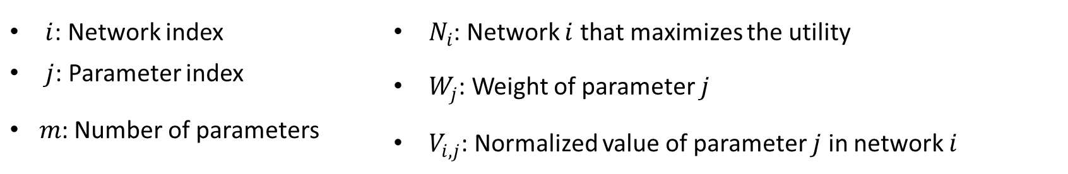

Vertical Handoff Decision Techniques
  SAW:
    Summative Additive Weighting
    Each parameter is given a weight and each parameter is normalized
    $N_{i}=$ ${argmax}_{i}(\sum_{j=1}^{m}{W_{j}V_{i,j}})$
$i$: Network index | $N_{i}$: Network $i$ that maximizes the utility
$j$: Parameter index | $W_{j}$: Weight of parameter $j$
𝑚: Number of parameters | $V_{i,j}$: Normalized value of parameter $j$ in network $i$

Slide 42
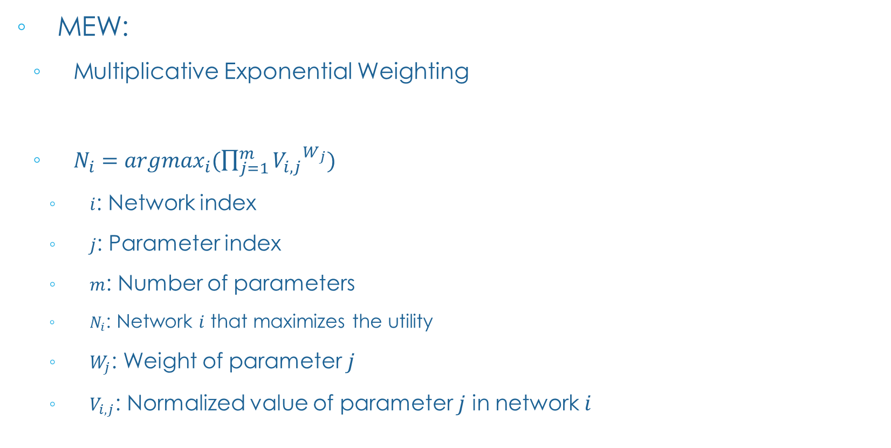
Vertical Handoff Decision Techniques
  MEW:
    Multiplicative Exponential Weighting
    $N_{i}=$ ${argmax}_{i}(\prod_{j=1}^{m}{{V_{i,j}}^{W_{j}}})$
      $i$: Network index
      $j$: Parameter index
      $m$: Number of parameters
      $N_{i}$: Network $i$ that maximizes the utility
      $W_{j}$: Weight of parameter $j$
      $V_{i,j}$: Normalized value of parameter $j$ in network $i$

Slide 43
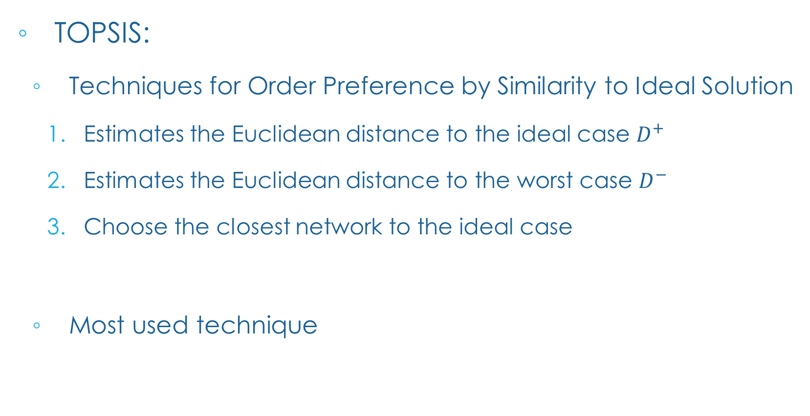
Vertical Handoff Decision Techniques
  TOPSIS:
    Techniques for Order Preference by Similarity to Ideal Solution
      Estimates the Euclidean distance to the ideal case $D^{+}$
      Estimates the Euclidean distance to the worst case $D^{−}$
      Choose the closest network to the ideal case
    Most used technique

Slide 44
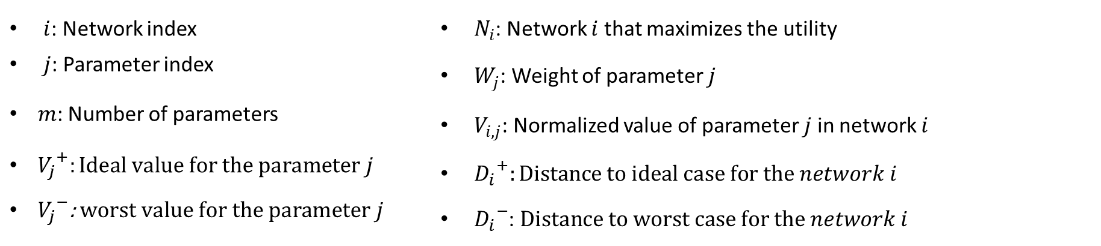

Vertical Handoff Decision Techniques
  TOPSIS:
${D^{+}}_{i}=\sqrt{\sum_{j=1}^{m}{{W_{j}}^{2}{(V_{i,j} −{V_{j}}^{+})}^{2}}} {D^{−}}_{i}=\sqrt{\sum_{j=1}^{m}{{W_{j}}^{2}{(V_{i,j} −{V_{j}}^{−})}^{2}}}$
$N_{i}$ = ${argmin}_{i}\left(\frac{{D^{+}}_{i}}{{D^{+}}_{i}+{D^{−}}_{i}}\right)$
$i$: Network index | $N_{i}$: Network $i$ that maximizes the utility
$j$: Parameter index | $W_{j}$: Weight of parameter $j$
𝑚: Number of parameters | $V_{i,j}$: Normalized value of parameter $j$ in network $i$
${V_{j}}^{+}:Ideal value for the parameter j$ | ${D_{i}}^{+}:Distance to ideal case for the network i$
${V_{j}}^{−}$: $worst value$ $for the parameter j$ | ${D_{i}}^{−}$: $Distance to worst case for the network i$

Slide 45
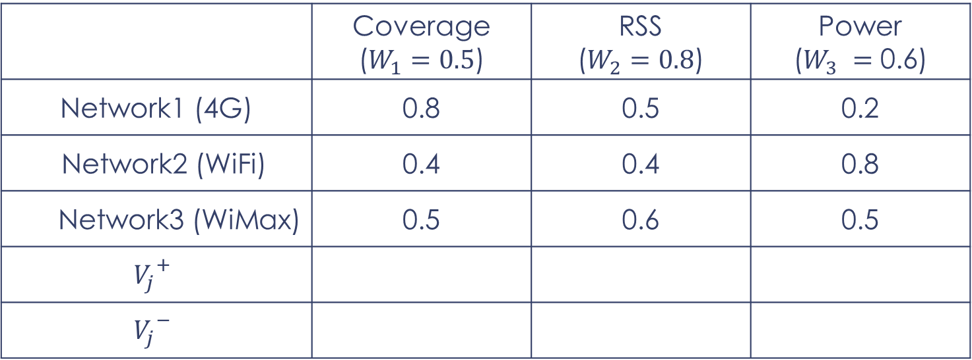
Vertical Handoff Decision Techniques
  TOPSIS example:
 | Coverage ($W_{1}=0.5$) | RSS ($W_{2}=0.8$) | Power ($W_{3} =$ 0.6)
Network1 (4G) | 0.8 | 0.5 | 0.2
Network2 (WiFi) | 0.4 | 0.4 | 0.8
Network3 (WiMax) | 0.5 | 0.6 | 0.5
$${V_{j}}^{+}$$
$${V_{j}}^{−}$$

Slide 46
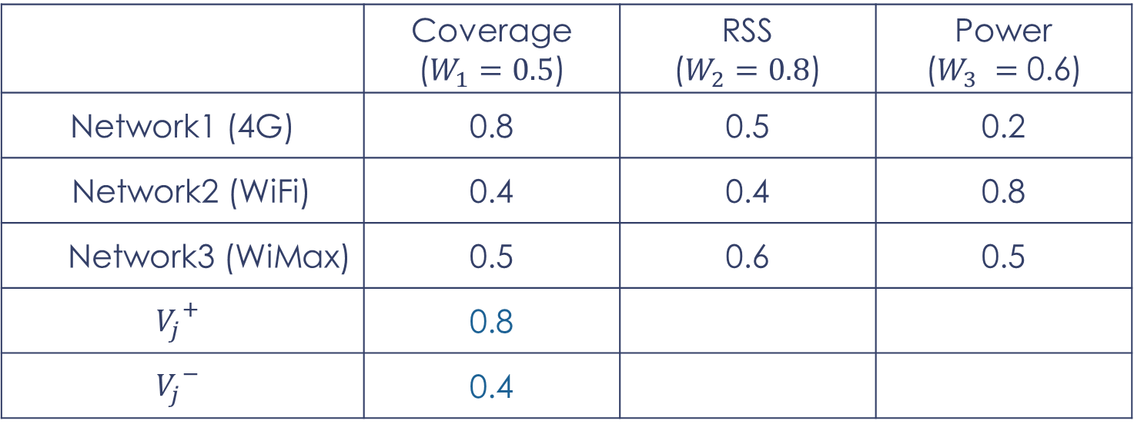
Vertical Handoff Decision Techniques
  TOPSIS example:
 | Coverage ($W_{1}=0.5$) | RSS ($W_{2}=0.8$) | Power ($W_{3} =$ 0.6)
Network1 (4G) | 0.8 | 0.5 | 0.2
Network2 (WiFi) | 0.4 | 0.4 | 0.8
Network3 (WiMax) | 0.5 | 0.6 | 0.5
$${V_{j}}^{+}$$ | 0.8
$${V_{j}}^{−}$$ | 0.4

Slide 47
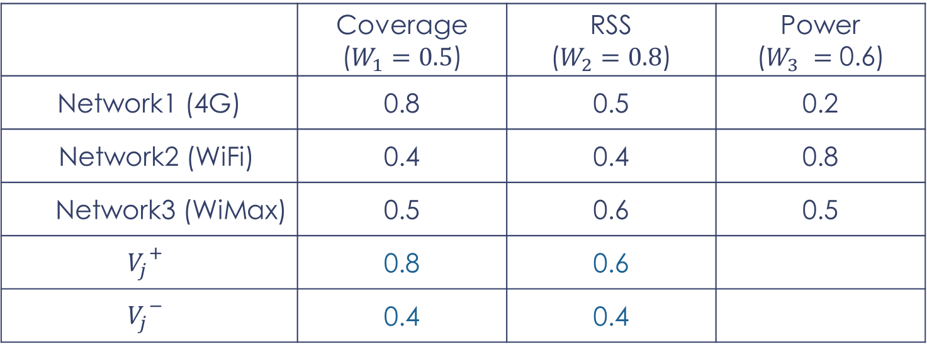
Vertical Handoff Decision Techniques
  TOPSIS example:
 | Coverage ($W_{1}=0.5$) | RSS ($W_{2}=0.8$) | Power ($W_{3} =$ 0.6)
Network1 (4G) | 0.8 | 0.5 | 0.2
Network2 (WiFi) | 0.4 | 0.4 | 0.8
Network3 (WiMax) | 0.5 | 0.6 | 0.5
$${V_{j}}^{+}$$ | 0.8 | 0.6
$${V_{j}}^{−}$$ | 0.4 | 0.4

Slide 48
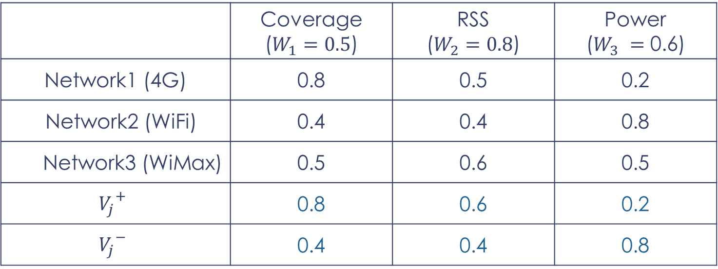
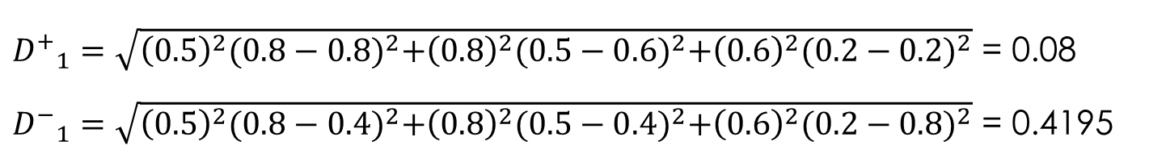
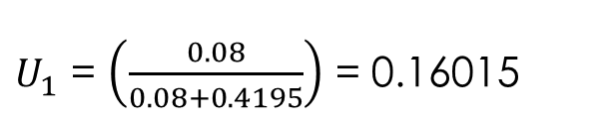
Vertical Handoff Decision Techniques
  TOPSIS example:
 | Coverage ($W_{1}=0.5$) | RSS ($W_{2}=0.8$) | Power ($W_{3} =$ 0.6)
Network1 (4G) | 0.8 | 0.5 | 0.2
Network2 (WiFi) | 0.4 | 0.4 | 0.8
Network3 (WiMax) | 0.5 | 0.6 | 0.5
$${V_{j}}^{+}$$ | 0.8 | 0.6 | 0.2
$${V_{j}}^{−}$$ | 0.4 | 0.4 | 0.8
${D^{+}}_{1}=\sqrt{{\left(0.5\right)}^{2}{(0.8−0.8)}^{2}+{\left(0.8\right)}^{2}{(0.5−0.6)}^{2}+{\left(0.6\right)}^{2}{(0.2−0.2)}^{2}}$ = 0.08
${D^{−}}_{1}=\sqrt{{\left(0.5\right)}^{2}{(0.8−0.4)}^{2}+{\left(0.8\right)}^{2}{(0.5−0.4)}^{2}+{\left(0.6\right)}^{2}{(0.2−0.8)}^{2}}$ = 0.4195
$U_{1}$ = $\left(\frac{0.08}{0.08+0.4195}\right)$ = 0.16015

Slide 49
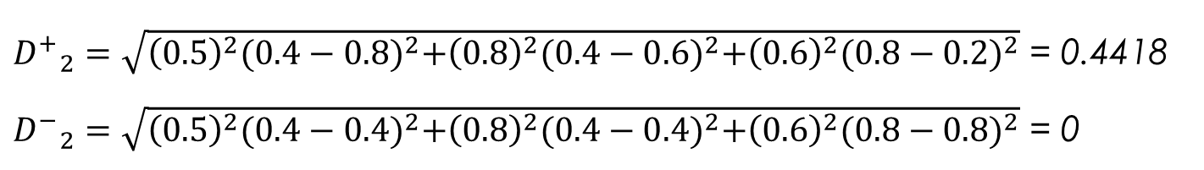
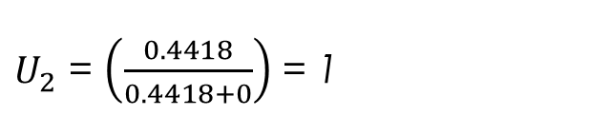
Vertical Handoff Decision Techniques
  TOPSIS example:
 | Coverage ($W_{1}=0.5$) | RSS ($W_{2}=0.8$) | Power ($W_{3} =$ 0.6)
Network1 (4G) | 0.8 | 0.5 | 0.2
Network2 (WiFi) | 0.4 | 0.4 | 0.8
Network3 (WiMax) | 0.5 | 0.6 | 0.5
$${V_{j}}^{+}$$ | 0.8 | 0.6 | 0.2
$${V_{j}}^{−}$$ | 0.4 | 0.4 | 0.8
${D^{+}}_{2}=\sqrt{{\left(0.5\right)}^{2}{(0.4−0.8)}^{2}+{\left(0.8\right)}^{2}{(0.4−0.6)}^{2}+{\left(0.6\right)}^{2}{(0.8−0.2)}^{2}}$ = 0.4418
${D^{−}}_{2}=\sqrt{{\left(0.5\right)}^{2}{(0.4−0.4)}^{2}+{\left(0.8\right)}^{2}{(0.4−0.4)}^{2}+{\left(0.6\right)}^{2}{(0.8−0.8)}^{2}}$ = 0
$U_{2}$ = $\left(\frac{0.4418}{0.4418+0}\right)$ = 1

Slide 50
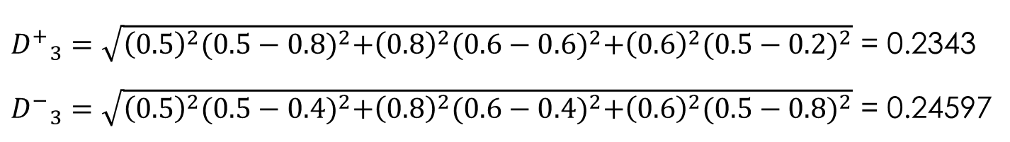
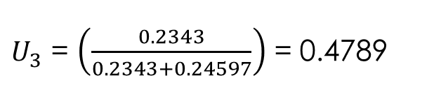
Vertical Handoff Decision Techniques
  TOPSIS example:
 | Coverage ($W_{1}=0.5$) | RSS ($W_{2}=0.8$) | Power ($W_{3} =$ 0.6)
Network1 (4G) | 0.8 | 0.5 | 0.2
Network2 (WiFi) | 0.4 | 0.4 | 0.8
Network3 (WiMax) | 0.5 | 0.6 | 0.5
$${V_{j}}^{+}$$ | 0.8 | 0.6 | 0.2
$${V_{j}}^{−}$$ | 0.4 | 0.4 | 0.8
${D^{+}}_{3}=\sqrt{{\left(0.5\right)}^{2}{(0.5−0.8)}^{2}+{\left(0.8\right)}^{2}{(0.6−0.6)}^{2}+{\left(0.6\right)}^{2}{(0.5−0.2)}^{2}}$ = 0.2343
${D^{−}}_{3}=\sqrt{{\left(0.5\right)}^{2}{(0.5−0.4)}^{2}+{\left(0.8\right)}^{2}{(0.6−0.4)}^{2}+{\left(0.6\right)}^{2}{(0.5−0.8)}^{2}}$ = 0.24597
$U_{3}$ = $\left(\frac{0.2343}{0.2343+0.24597}\right)$ = 0.4789

Slide 51
Vertical Handoff Decision Techniques
  TOPSIS example:
 | Coverage ($W_{1}=0.5$) | RSS ($W_{2}=0.8$) | Power ($W_{3} =$ 0.6)
Network1 (4G) | 0.8 | 0.5 | 0.2
Network2 (WiFi) | 0.4 | 0.4 | 0.8
Network3 (WiMax) | 0.5 | 0.6 | 0.5
$${V_{j}}^{+}$$ | 0.8 | 0.6 | 0.2
$${V_{j}}^{−}$$ | 0.4 | 0.4 | 0.8
$Best Alternative=$ ${argmin}_{i}(0.16015, 1, 0.47885)$ = Network1

Slide 52
AGENDA
  Heterogeneous Wireless Networks
  Vertical Handoff
  Vertical Handoff Management Process
  Vertical Handoff Decision Techniques
  Game Theory Introduction
  Game Theory in Vertical Handoff

Slide 53
Game Theory Introduction
What is game theory ?
  A useful analytical tool.
  Used to model situations where there are multiple decision makers.
  Decision makers’ actions might have mutual ,possibly conflicting, consequences.

Slide 54
Game Theory Introduction
What is game theory ?
  Usually used in the field of economics.
  Ex : Decide Whether a company should enter a new market.
  The new market’s payoff depends on the decision made by the company’s competitors.

Slide 55
Game Theory Introduction
Non-cooperative Games
  Players have conflicting interests.
  All players are rational.
  Aim to maximize their own payoffs or utilities.
Static games
  Also called a single-stage game.
  Each player has only one move as a strategy.

Slide 56
Game Theory Introduction
Static game formulation G(P, S, U)
  A static game is composed of the following components
    P : A set of players or decision makers.
    S : A set of strategies/moves/actions for each player.
    Strategy profile s : Set of chosen strategies by each player s = {s₁, s₂, .. }
    U : A set of utility functions for each player.
    Maps a strategy profile to the payoff of a certain player.

Slide 57
Game Theory Introduction
Static game example (Multiple access Game)
  Players
    Share the same communication channel.
    Want to transmit a single packet each to a different receiver.
    The players and receivers are in the same power range.
P₁
P₂

Slide 58
Game Theory Introduction
Static game example (Multiple access Game)
  Strategy/moves/actions:
    Each player can do one of two actions:
      Access the channel (A)
      Wait (W)
P₁
P₂

Slide 59
Game Theory Introduction
Static game example (Multiple access Game)
  Utility function/ payoff matrix
P₂
W
A
W
0, 0
P₁
P₂
P₁
A

Slide 60

Game Theory Introduction
Static game example (Multiple access Game)
  Utility function/ payoff matrix
P₂
W
A
W
0, 0
P₁
P₂
P₁
A
1-C, 0

Slide 61
Game Theory Introduction
Static game example (Multiple access Game)
  Utility function/ payoff matrix
P₂
W
A
W
0, 0
0, 1-C
P₁
P₂
P₁
A
1-C, 0

Slide 62
Game Theory Introduction
Static game example (Multiple access Game)
  Utility function/ payoff matrix
P₂
W
A
W
0, 0
0, 1-C
P₁
P₂
P₁
A
1-C, 0
-C, -C

Slide 63
Game Theory Introduction
Nash equilibrium (Game solution)
  Is a state where no player has any incentive to change its strategy.
  Every player has the strategy that maximizes its payoffs given the other players’ strategies.
  Is not necessarily the optimal solution.

Slide 64
Game Theory Introduction
Nash equilibrium (Game solution)
  P₁: W, P₂: W
P₂
W
A
W
0, 0
0, 1-C
P₁
A
1-C, 0
-C, -C

Slide 65
Game Theory Introduction
Nash equilibrium (Game solution)
  P₁: W, P₂: W
W
P₂
A
W
0, 0
0, 1-C
P₁
A
1-C, 0
-C, -C
No Equilibrium!

Slide 66
Game Theory Introduction
Nash equilibrium (Game solution)
  P₁: W, P₂: A
P₂
W
A
W
0, 0
0, 1-C
P₁
A
1-C, 0
-C, -C

Slide 67
Game Theory Introduction
Nash equilibrium (Game solution)
  P₁: W, P₂: A
P₂
W
A
W
0, 0
0, 1-C
P₁
A
1-C, 0
-C, -C

Slide 68
Game Theory Introduction
Nash equilibrium (Game solution)
  P₁: W, P₂: A
P₂
W
A
W
0, 0
0, 1-C
P₁
A
1-C, 0
-C, -C
Equilibrium !

Slide 69
Game Theory Introduction
Nash equilibrium (Game solution)
  P₁: A, P₂: A
P₂
W
A
W
0, 0
0, 1-C
P₁
A
1-C, 0
-C, -C

Slide 70
Game Theory Introduction
Nash equilibrium (Game solution)
  P₁: A, P₂: A
P₂
A
W
W
0, 0
0, 1-C
P₁
A
1-C, 0
-C, -C
No Equilibrium !

Slide 71
Game Theory Introduction
Nash equilibrium (Game solution)
  The Solution of the game by Nash equilibrium is either:
    Player 1 Access the channel & Player 2 waits.
    Player 1 waits & Player 2 Access the channel.
  In both cases no player takes any benefit if changes its strategy.

Slide 72
AGENDA
  Heterogeneous Wireless Networks
  Vertical Handoff
  Vertical Handoff Management Process
  Vertical Handoff Decision Techniques
  Game Theory Introduction
  Game Theory in Vertical Handoff

Slide 73
Game Theory in Vertical Handoff
Game between Mobile users
  Mobile Users compete for joining a particular network.
  Each Mobile user aims to maximize its QoS.
  Formulation:
    Players : Mobile Users.
    Strategy : Each mobile user can either:
      Connect.
      No Change.
    Utilities : All mobile users aim to maximize their own QoS.
  Solution:
  A state where all mobile users have no incentive to change their decision.

Slide 74
Game Theory in Vertical handoff
Game between Wireless Networks
  Wireless Networks compete for a particular Mobile user.
  Each Network aims to maximize the revenue of its service.
  Formulation:
    Players : Wireless Networks.
    Strategy : Each Wireless Network can either:
      Accept the user connection.
      Reject the user connection.
    Utilities : All Networks aim to maximize their own revenue.
  Solution:
  A state where all Networks have no incentive to change their decision.

Slide 75
Game Theory in Vertical Handoff
Game between Mobile Users & Wireless Networks
  Mobile users and wireless networks mutually select each other.
  Both aim to maximize their own payoffs.
  Formulation:
    Players : U(All mobile users combined), N (All Networks combined).
    Strategy :
      Action for U {U₁ connects to N₁, U₂ No change, ..etc}.
      Action for N {N₁ accepts U₁, N₂ declines U₃, … etc}.
    Utilities : Maximize revenue for all users and networks.
  Solution:
  A state where all Mobile users and networks have no intensive to change their strategies.

Slide 76
AGENDA
  Heterogeneous Wireless Networks
  Vertical Handoff
  Vertical Handoff Management Process
  Vertical Handoff Decision Techniques
  Game Theory Introduction
  Game Theory in Vertical Handoff

Slide 77


Slide 78
Useful Resources
  https://ieeexplore.ieee.org/document/8229862
  https://infoscience.epfl.ch/record/79715?ln=en
  https://www.investopedia.com/terms/n/nash-equilibrium.asp
  https://link.springer.com/chapter/10.1007/978-981-10-8240-5_47
  https://api.semanticscholar.org/CorpusID:16584343

